Slide 1
HISTORICAL
EVENTS
EXPLORATION
USING
AUGMENTED-REALITY
IT07
20R21A1254 - Shaik Abid Hussain
20R21A1243 - Nipun Seeram
20R21A1229 - K. Naveen Babu
https://github.com/IT-07/Historical-Events-Exploration

Slide 2
ABSTRACT
The "Historic Events Exploration using Augmented Reality" project aims to leverage augmented reality (AR) technology to provide an immersive and educational experience for users interested in exploring and learning about historical events. By combining real-world surroundings with digital historical content, this project seeks to bridge the gap between traditional learning methods and modern interactive technologies. This project's primary goal is to create an engaging platform that enables users to interact with and gain a deeper understanding of significant historical events in a dynamic and memorable way

Slide 3
OBJECTIVES
Develop an AR application that brings historical events to life by overlaying digital information onto physical surroundings.
Create a user-friendly interface to make historical exploration accessible to a wide range of users, including students, history enthusiasts, and tourists.
Enhance user engagement and learning outcomes by incorporating interactive elements, such as quizzes, storytelling, and gamification.
Enable customization and personalization options, allowing users to tailor their historical exploration experiences.

Slide 4
PROPOSED SYSTEM
Our proposed system, leverages Augmented Reality to transform historical exploration. It features a user-friendly interface accessible through AR-compatible devices such as smartphones and AR glasses. Historical content, including 3D models, images, and videos, is meticulously curated and stored in a central database. It Includes context-aware information based on users' physical surrounding, ensuring an immersive and interactive experience .
The proposed system uses AR Foundation which is a cross platform framework that allows developers to create AR Apps with Unity. It combines the full power of the Unity platform with essential core features from ARKit, ARCore, Magic Leap, and HoloLens.

Slide 5
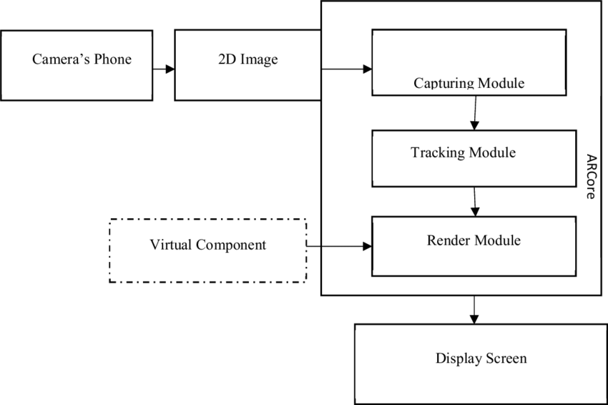
ARCHITECTURE

Slide 6
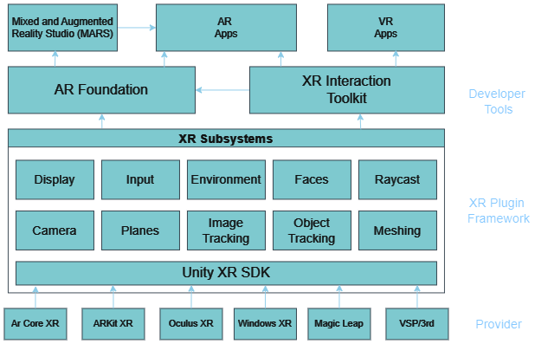
ARCHITECTURE

Slide 7
RESEARCH QUESTIONS
How can AR technology be effectively utilized to create an immersive and engaging experience for users exploring historical events?
What are the best practices for blending history with interactive and entertaining elements in an AR-based historical exploration platform?
How does the use of AR impact the retention and comprehension of historical information among users, particularly students and history enthusiasts?

Slide 8
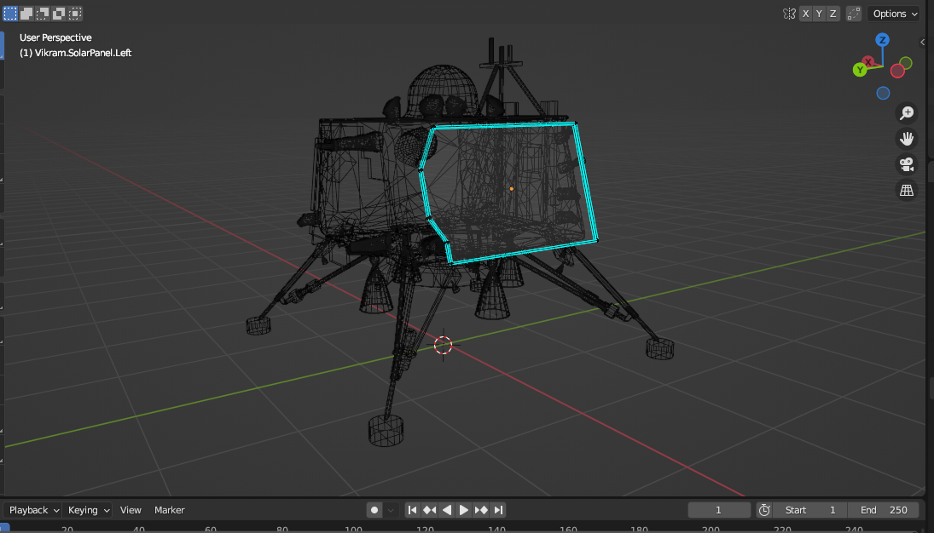
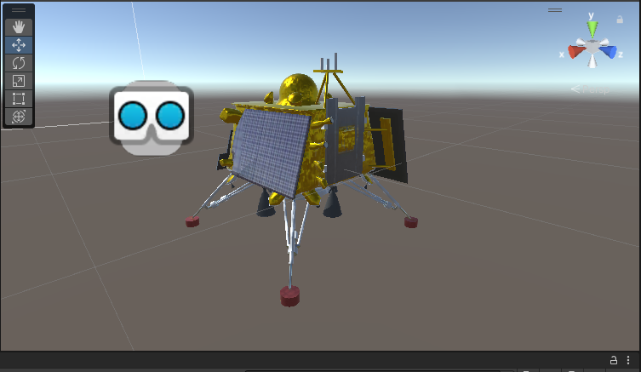
Implementation
GItHub: Click Here
Literature Survey: Click Here

Slide 9

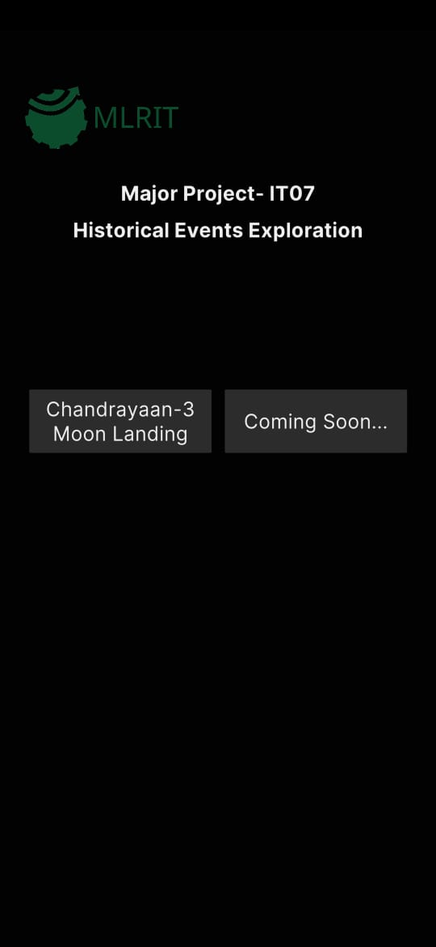
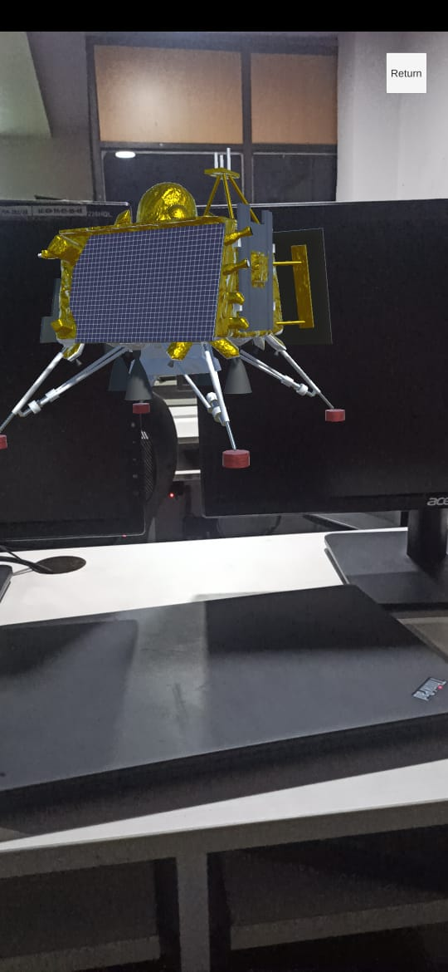
Current Progress

Slide 10
References
Unity AR Foundation Documentation.
AR Development Unity Documentation.
Google AR Core Documentation .

Slide 11
Thank You

